Slide 1
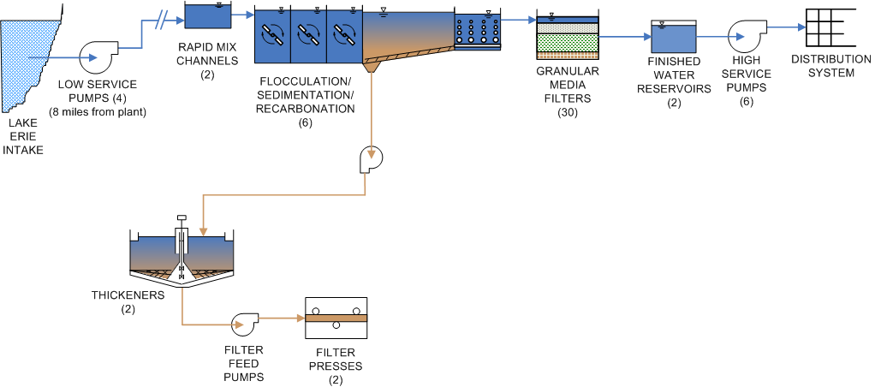
Low Service PS Improvements
$20,633,000
Electrical Upgrades, Pump Rehab,
Piping Gallery Improvements
Equipment Replacements, Security
Flocculation/Sedimentation Basin Impr.
$14,321,000
Equipment Replacements and Structural
Improvements
High Service PS Improvements
$12,172,000
Electrical Upgrades, Pump Rehab, Piping Gallery
Improvements, Equipment Replacements
Raw Water Intake Impr.
$1,775,000
Structural, Interior
and Exterior Improvements
Filter System Improvements
$37,695,000
Piping and Valve Replacements and Rehabilitation, Pumping System Impr.,
Filter Wash Water Facility Impr., etc.
Chemical Feed System Impr.
$10,384,000
Carbon, Alum, Lime and Soda Ash
Heatherdowns PS Impr.
$5,530,000
Electrical Upgrades, Pump
And Equipment Rehab,
Structural Improvements
New Disinfection Facilities
$8,000,000
Chlorine and Chlorine Dioxide Generation and Feed Equip., Masonry Building
Additional Facility Improvements
SCADA System Replacement $5,000,000
Power Supply Improvements $ 7,000,000
HVAC Improvements $1,869,000
Filter Plant Roof Replacements $15,000,000
5. Structural Repairs to Plant $2,638, 000
6. Administration Bldg Offices and Property
Acquisition $4,804,000
Treatment Plant Additions
(Total $96,600,000)
Basin 7 – includes a 20 MGD Treatment Train including, Flocculation, Sedimentation and Filtration Facilities - $53,400,000
Basin 8 – includes a 20 MGD Treatment Train including, Flocculation, Sedimentation and Filtration Facilities - $43,200,000
Residuals Handling
$20,542,000
Press and Thickener Rehabilitation, Additional Thickener Tank, Additional Press and Bldg Expansion
Toledo Division of Water Treatment - Improvement Costs
Total Cost - $263,963,000

